Slide 1



UNIT 2
Look back 2
Part 4

Slide 2
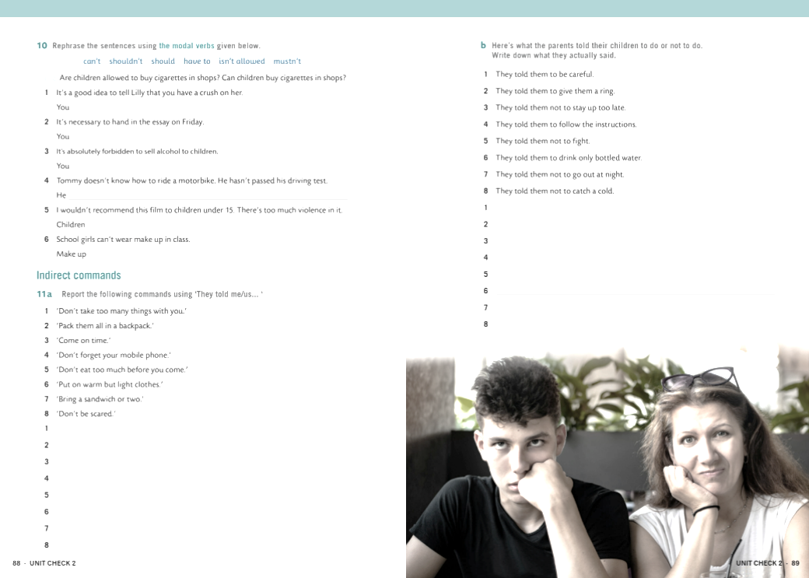
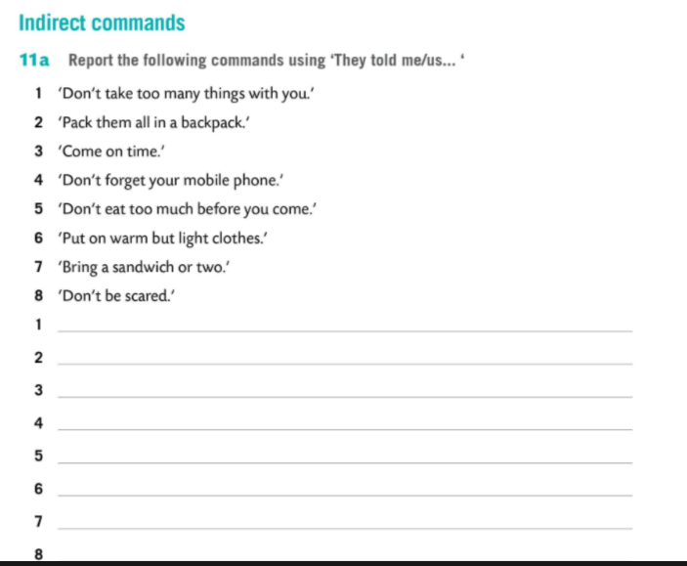
They told us not to take too many things with us.
They told us to pack them all in a backpack.
They told us to come on time.
They told us not to forget our mobile phones.
They told us not to eat too much before we came.
They told us to put on warm but light clothes.
They told us to bring a sandwich or two.
They told us not to be scared.

Slide 3
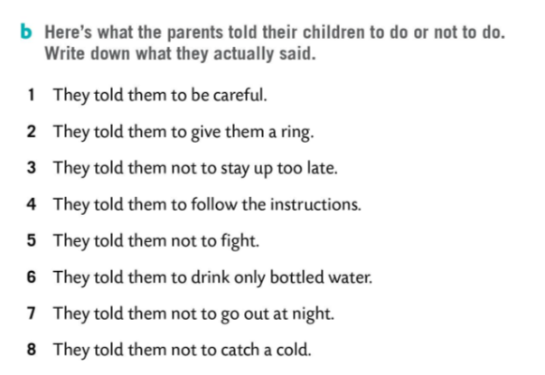

Be careful.
Give us a ring.
Don’t stay up late.
Follow the instructions.
Don’t fight.
Drink only bottled water.
Don’t go out at night.
Don’t catch a cold.

Slide 4
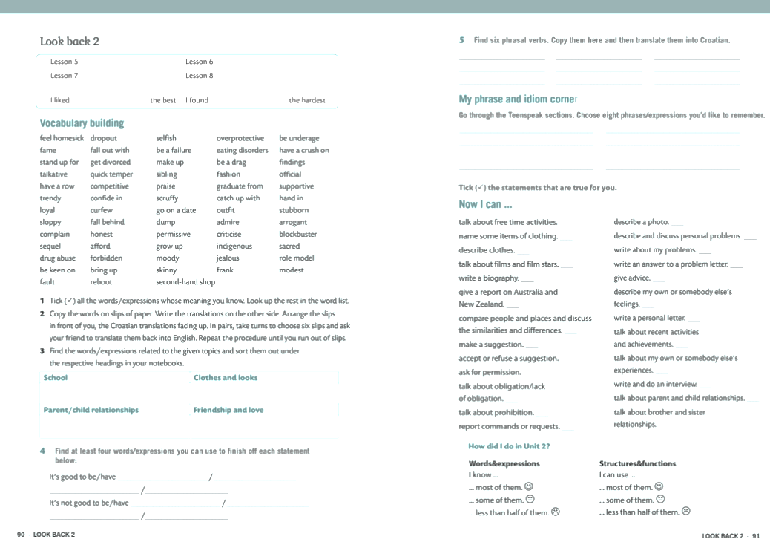
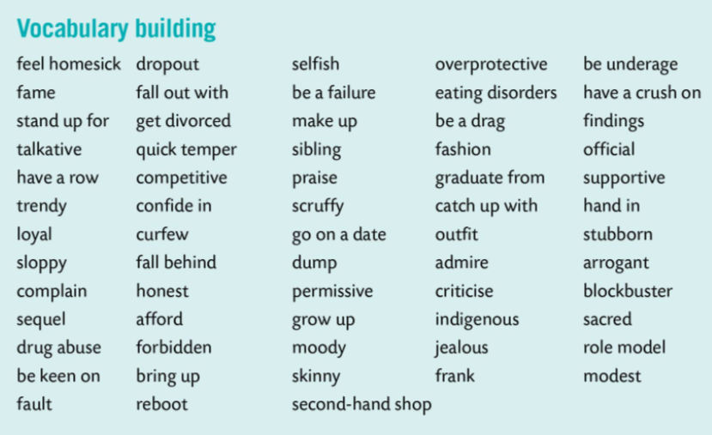

Slide 5
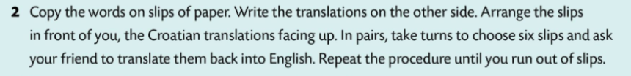

Slide 6
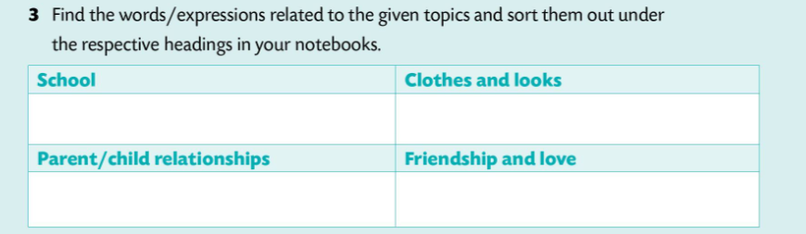
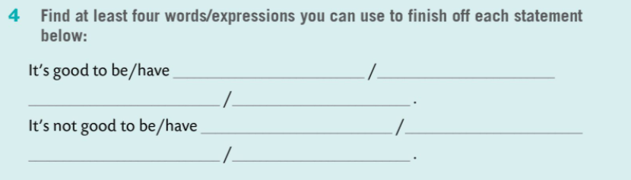
Graduate from, hand in …
Trendy, second-hand shop…
Have a row, confide in…
Loyal, frank …
frank
modest
role model
sloppy
arrogant
moody

Slide 7
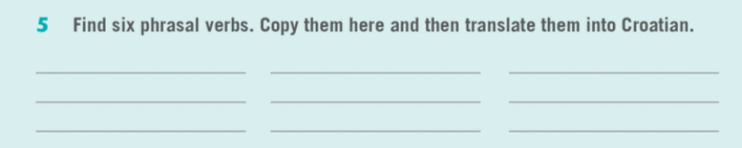
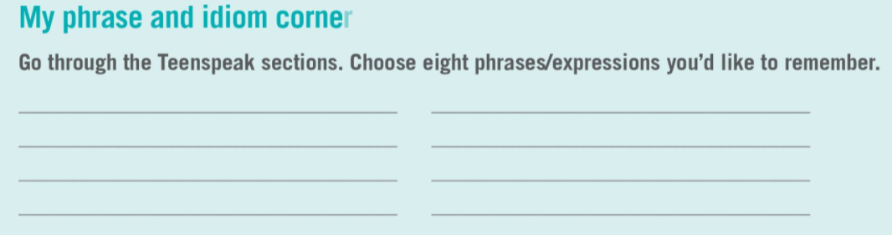
have a row – porječkati se, posvađati se
catch up with – sustići, dostići
fall behind - zaostati
be a failure – biti neuspješan
have a crush on – biti zaljubljen u nekoga
fall out with – posvađati se

Slide 8
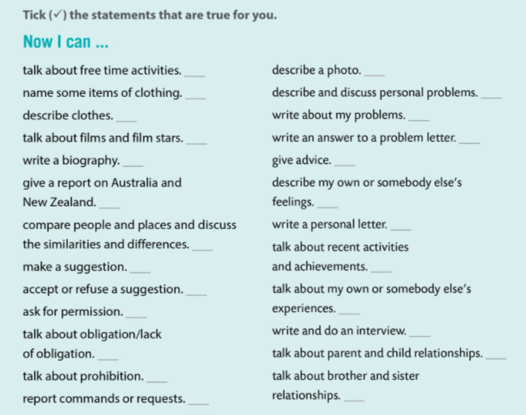
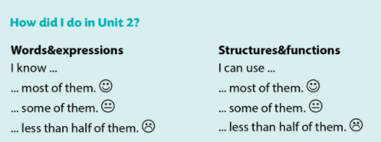
Tvrdnje koje su za tebe točne označi kvačicom.

